Slide 1
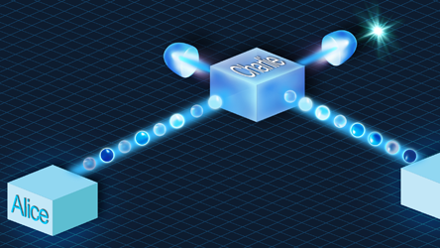
Update meeting 4
Joan, Juan & Timo

Slide 2
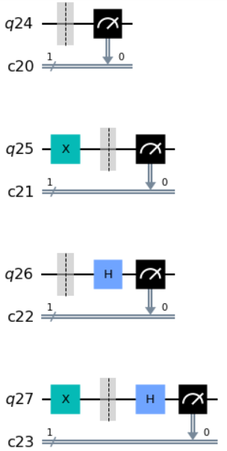
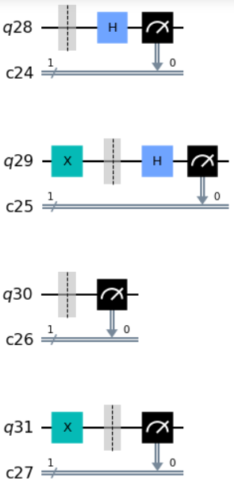
Basic BB84 Circuits

Slide 3
Alice Message | 0 |  |  |  |  |  | 0 |  |  |  |  |  | 0
Alice Basis | 0 |  |  |  |  |  | 0 |  |  |  |  |  | 1
Bob Basis | 0 |  |  |  |  |  | 1 |  |  |  |  |  | 0
Bob Message (measured) | 0 | 1 | 0 | 0 | 0 | … | 1 | 0 | 0 | 1 | 1 | … | 0 | 1 | 0 | 1 | …
16384
16384
16384

Slide 4
Alice Message | 0 |  |  |  |  |  | 0 |  |  |  |  |  | 0
Alice Basis | 0 |  |  |  |  |  | 0 |  |  |  |  |  | 1
Bob Basis | 0 |  |  |  |  |  | 1 |  |  |  |  |  | 0
Bob Message (measured) | 0 | 1 | 0 | 0 | 0 | … | 1 | 0 | 0 | 1 | 1 | … | 0 | 1 | 0 | 1 | …
16384
16384
16384
Shuffle
Alice Message | 0 | 1 | 1 | 1 | 0 | 0 | 1 | 0 | 0 | 1 | 1 | 0 | 0 | 1 | 1 | 0 | …
Alice Basis | 1 | 0 | 0 | 0 | 0 | 1 | 0 | 1 | 1 | 0 | 1 | 0 | 0 | 1 | 0 | 1 | …
Bob Basis | 0 | 0 | 0 | 1 | 0 | 0 | 0 | 0 | 0 | 0 | 0 | 1 | 1 | 1 | 0 | 0 | …
Bob Message (measured) | 0 | 1 | 1 | 0 | 0 | 0 | 0 | 1 | 1 | 1 | 0 | 1 | 0 | 0 | 1 | 1 | …

Slide 5
Alice Message | 0 |  |  |  |  |  | 0 |  |  |  |  |  | 0
Alice Basis | 0 |  |  |  |  |  | 0 |  |  |  |  |  | 1
Bob Basis | 0 |  |  |  |  |  | 1 |  |  |  |  |  | 0
Bob Message (measured) | 0 | 1 | 0 | 0 | 0 | … | 1 | 0 | 0 | 1 | 1 | … | 0 | 1 | 0 | 1 | …
16384
16384
16384
Shuffle
Alice Message | 0 | 1 | 1 | 1 | 0 | 0 | 1 | 0 | 0 | 1 | 1 | 0 | 0 | 1 | 1 | 0 | …
Alice Basis | 1 | 0 | 0 | 0 | 0 | 1 | 0 | 1 | 1 | 0 | 1 | 0 | 0 | 1 | 0 | 1 | …
Bob Basis | 0 | 0 | 0 | 1 | 0 | 0 | 0 | 0 | 0 | 0 | 0 | 1 | 1 | 1 | 0 | 0 | …
Bob Message (measured) | 0 | 1 | 1 | 0 | 0 | 0 | 0 | 1 | 1 | 1 | 0 | 1 | 0 | 0 | 1 | 1 | …

Slide 6
Alice Message | 0 |  |  |  |  |  | 0 |  |  |  |  |  | 0
Alice Basis | 0 |  |  |  |  |  | 0 |  |  |  |  |  | 1
Bob Basis | 0 |  |  |  |  |  | 1 |  |  |  |  |  | 0
Bob Message (measured) | 0 | 1 | 0 | 0 | 0 | … | 1 | 0 | 0 | 1 | 1 | … | 0 | 1 | 0 | 1 | …
16384
16384
16384
Shuffle
Alice Message | 0 | 1 | 1 | 1 | 0 | 0 | 1 | 0 | 0 | 1 | 1 | 0 | 0 | 1 | 1 | 0 | …
Alice Basis | 1 | 0 | 0 | 0 | 0 | 1 | 0 | 1 | 1 | 0 | 1 | 0 | 0 | 1 | 0 | 1 | …
Bob Basis | 0 | 0 | 0 | 1 | 0 | 0 | 0 | 0 | 0 | 0 | 0 | 1 | 1 | 1 | 0 | 0 | …
Bob Message (measured) | 0 | 1 | 1 | 0 | 0 | 0 | 0 | 1 | 1 | 1 | 0 | 1 | 0 | 0 | 1 | 1 | …
Majority voting gives a 1 in this case
This leaves a key length of 8*16384/10

Slide 7
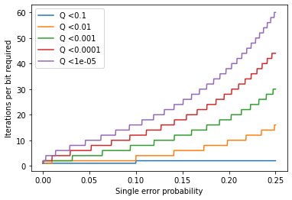
How many iterations are necessary?

Slide 8
Overview
Done
Developped a concept for the BB84 protocol with classical randomness
To Do (this week)
Questions
What do you think about the classical randomness BB84 protocol?
Juan: Code the classical randomness BB84 protocol
Joan: Finish E91 protocol
Started translating the code for IBM
Started developping the E91 protocol
Timo: Develop Eve attack strategies
IBM can (supposedly) do conditional gates, should we use them to try to implement the quantum randomness protocol?

